Slide 1



Mish: A Self Regularized
Non-Monotonic Activation Function
Diganta Misra
Landskape

Slide 2
In the memory of my late grandfather,
Prof. Dr. Fakir Mohan Misra

Slide 3
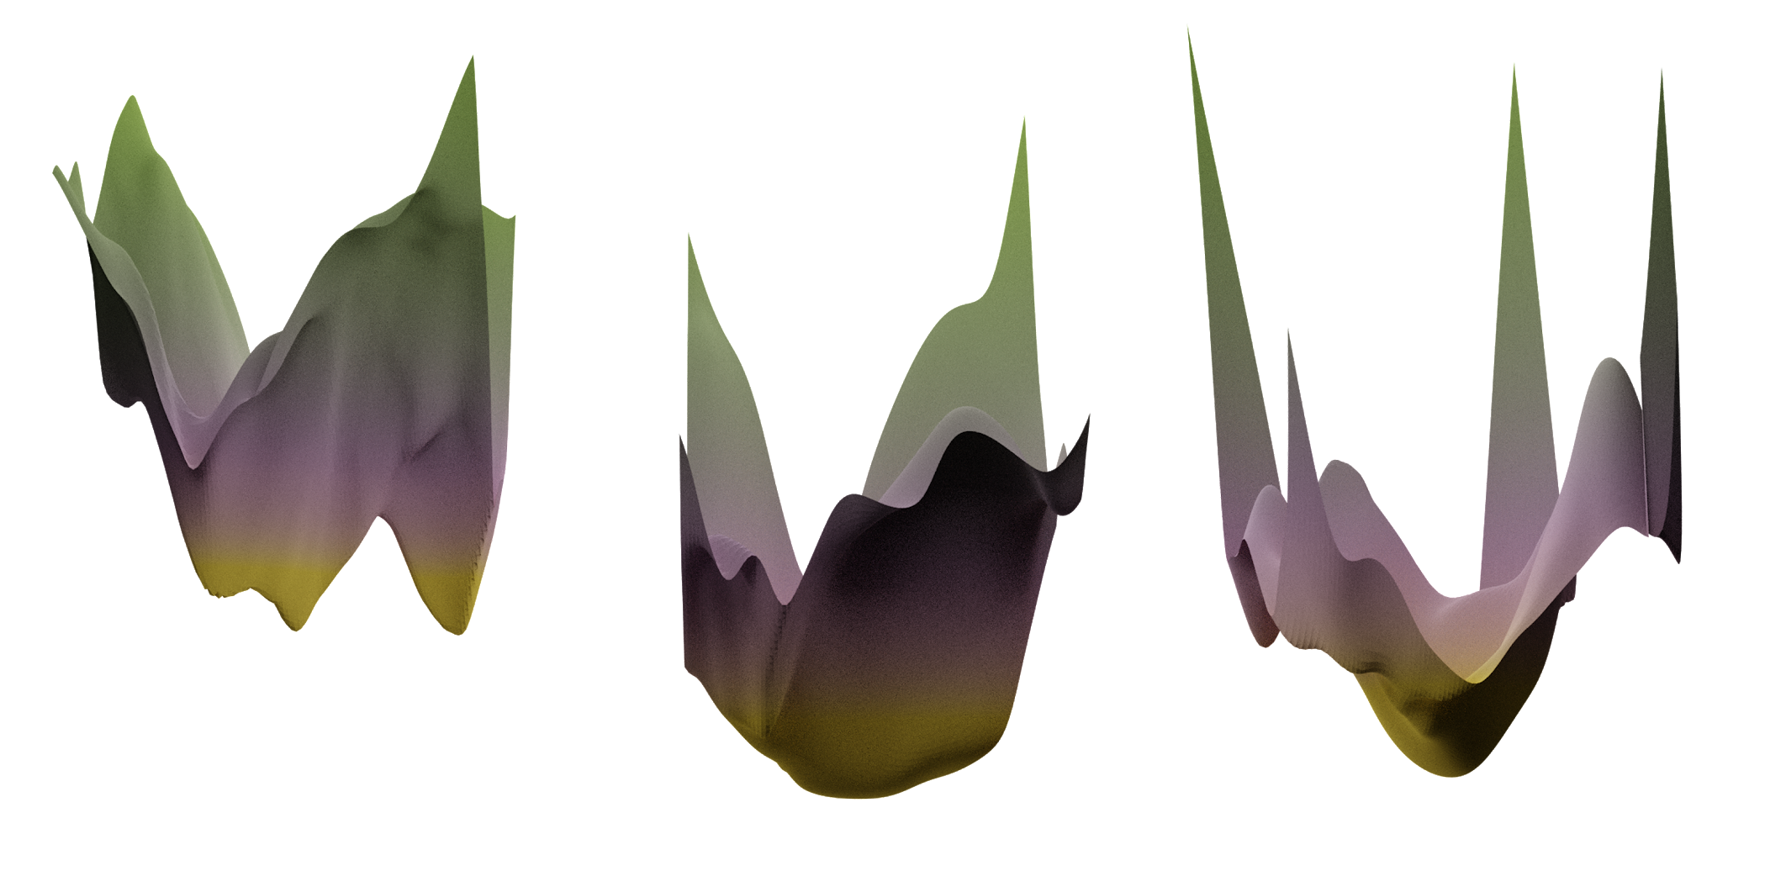
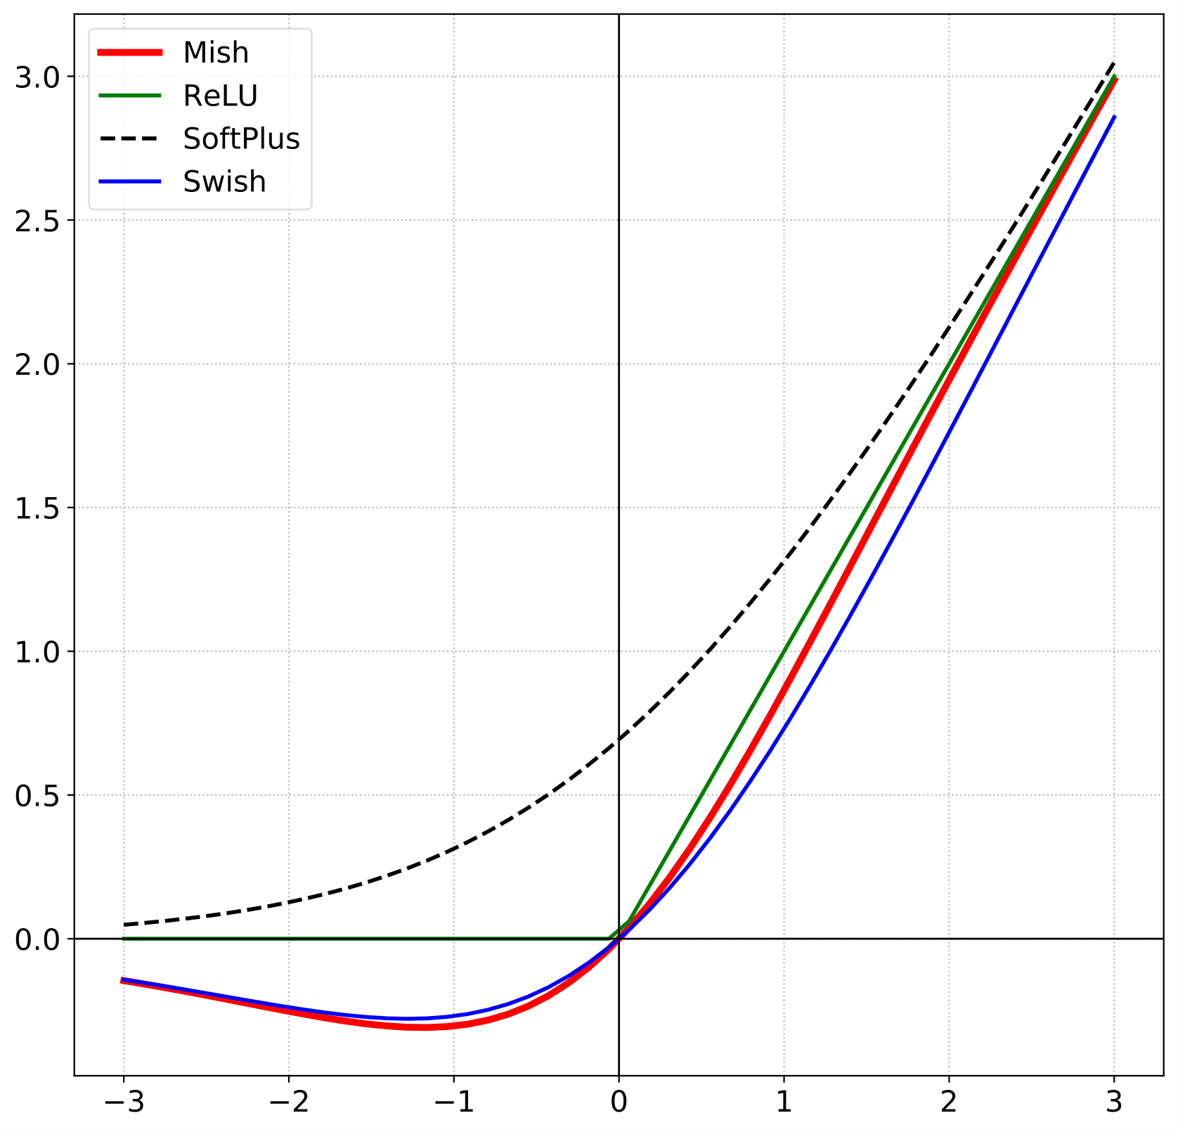
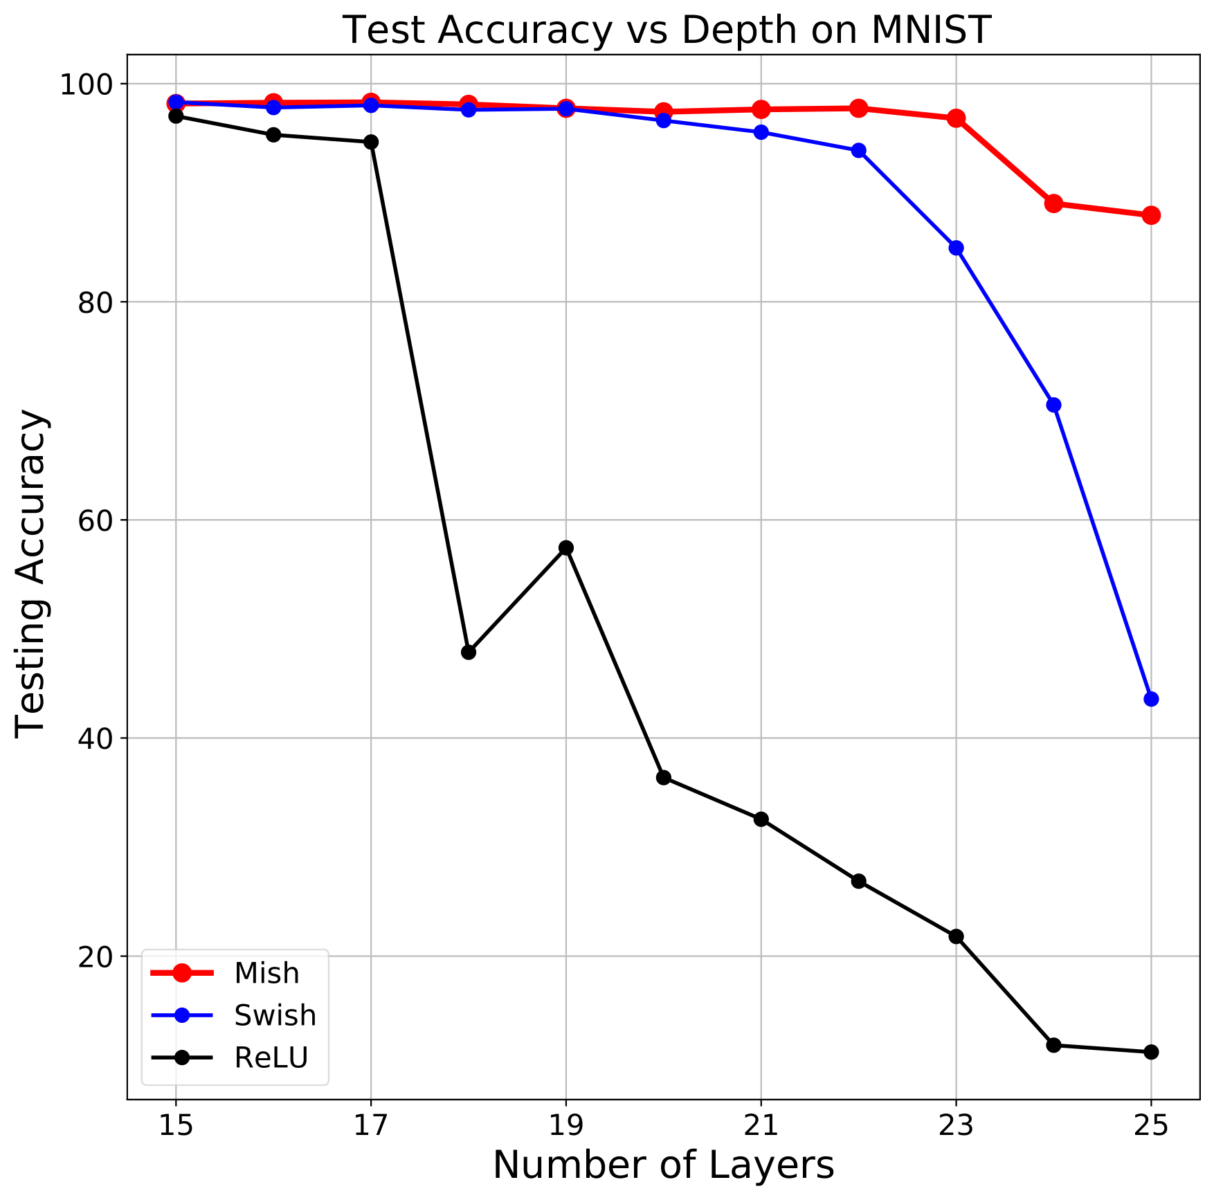
Overview
We propose “Mish”, a novel self regularized non-monotonic activation function. Mish is defined as: xtanh(softplus(x))
Mish promotes improved information propagation with respect to network depth, better generalization due to smooth and well conditioned loss landscapes.
We optimize Mish for GPU training with our custom implementation - “Mish CUDA” for easy and relatively low cost training in terms of training time.
ReLU
Mish
Swish

Slide 4
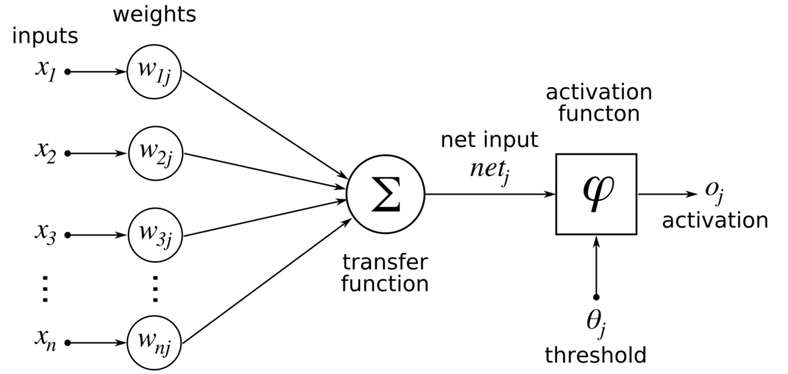
Activation Functions
Activation functions are a crucial component within any neural network architecture. The choice of activation functions within a network has adverse effects in the training dynamics of the network. The role of an activation function is to provide non-linearity.
Mathematically, an activation function can be realized as:
z = g(y) = g(∑_{i}w_{i}x_{i} +b)

Slide 5
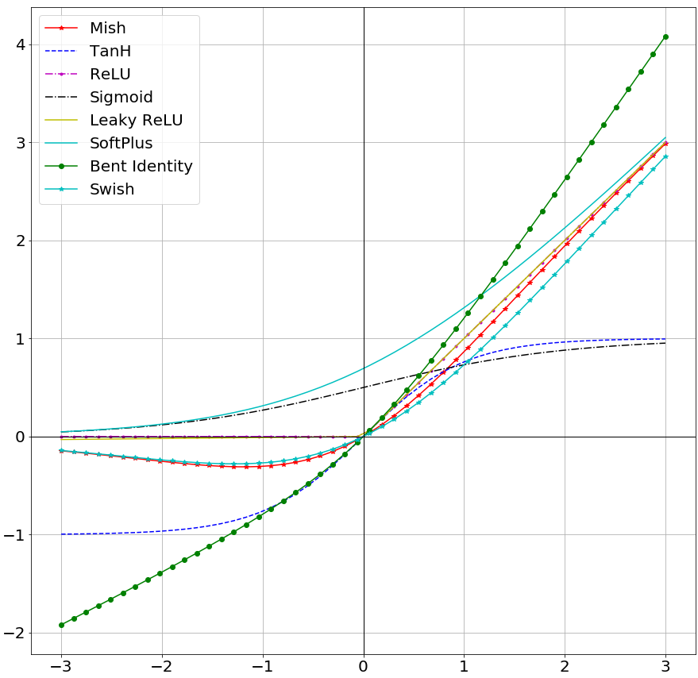
Activation Functions
Over the years in Deep Learning research, multiple activation functions have been proposed including EliSH, PReLU, ELU, RReLU, et cetera. However, ReLU has remained the default choice for most practitioners and researchers because of its simplicity, efficiency in different tasks and low cost for training. But, ReLU has its fair share of flaws which include - Dying ReLU which is caused to a collapse in gradient information due to complete thresholding of negative information. ReLU also does not perform well with increasing depth of the neural network architecture. This has prompted the investigation into more smooth and continuously differentiable options like Swish and GELU which have demonstrated recent success in various tasks.

Slide 6
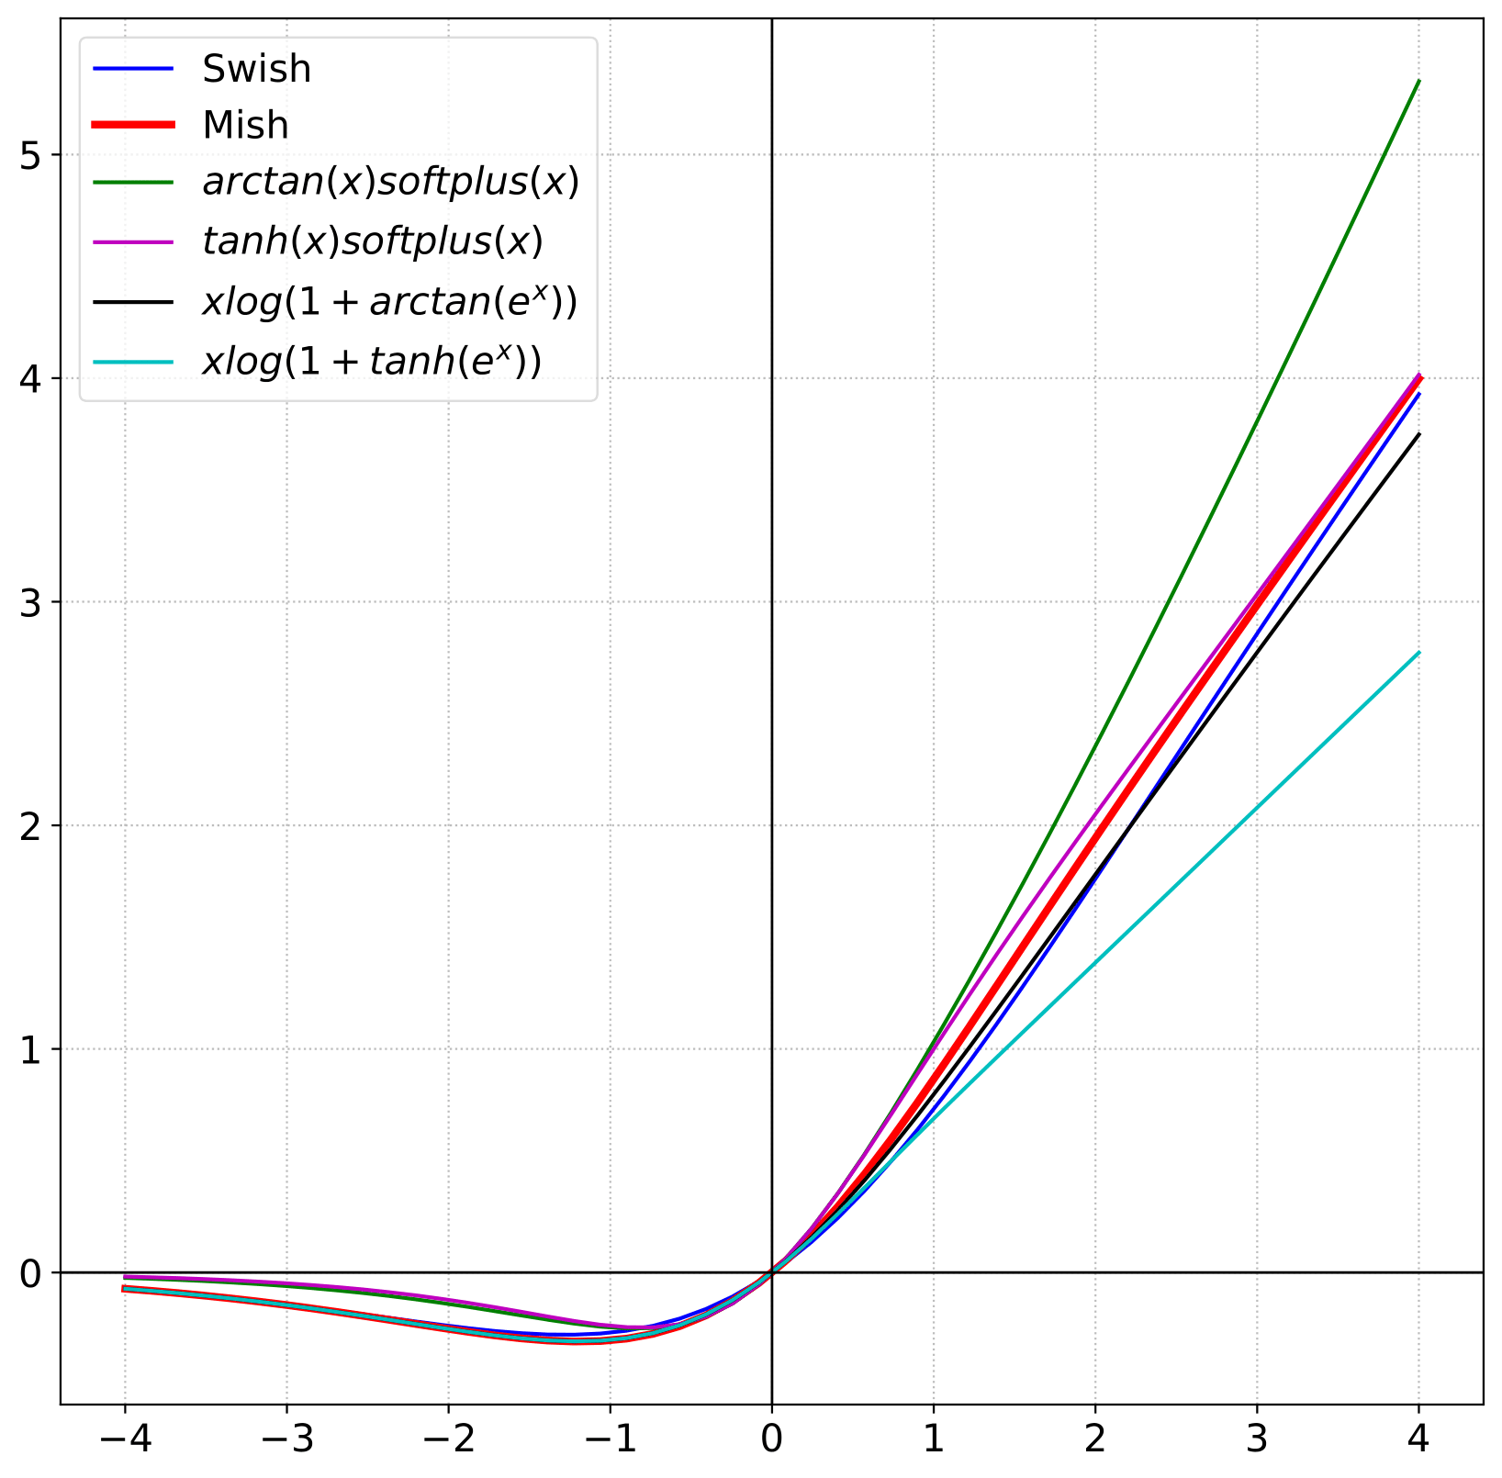
Motivation
Across theoretical research into activation functions, those sharing properties similar to Swish, which includes non-monotonicity, ability to preserve small negative weights, and a smooth profile, have been a recurring discussion. GELU which is used as a standard in the GPT-2 architecture is one of the prime examples. Swish was discovered by a NAS approach in a conditioned search space of different non-linearities not bounded by the crucial discriminative properties that define Swish.

Slide 7
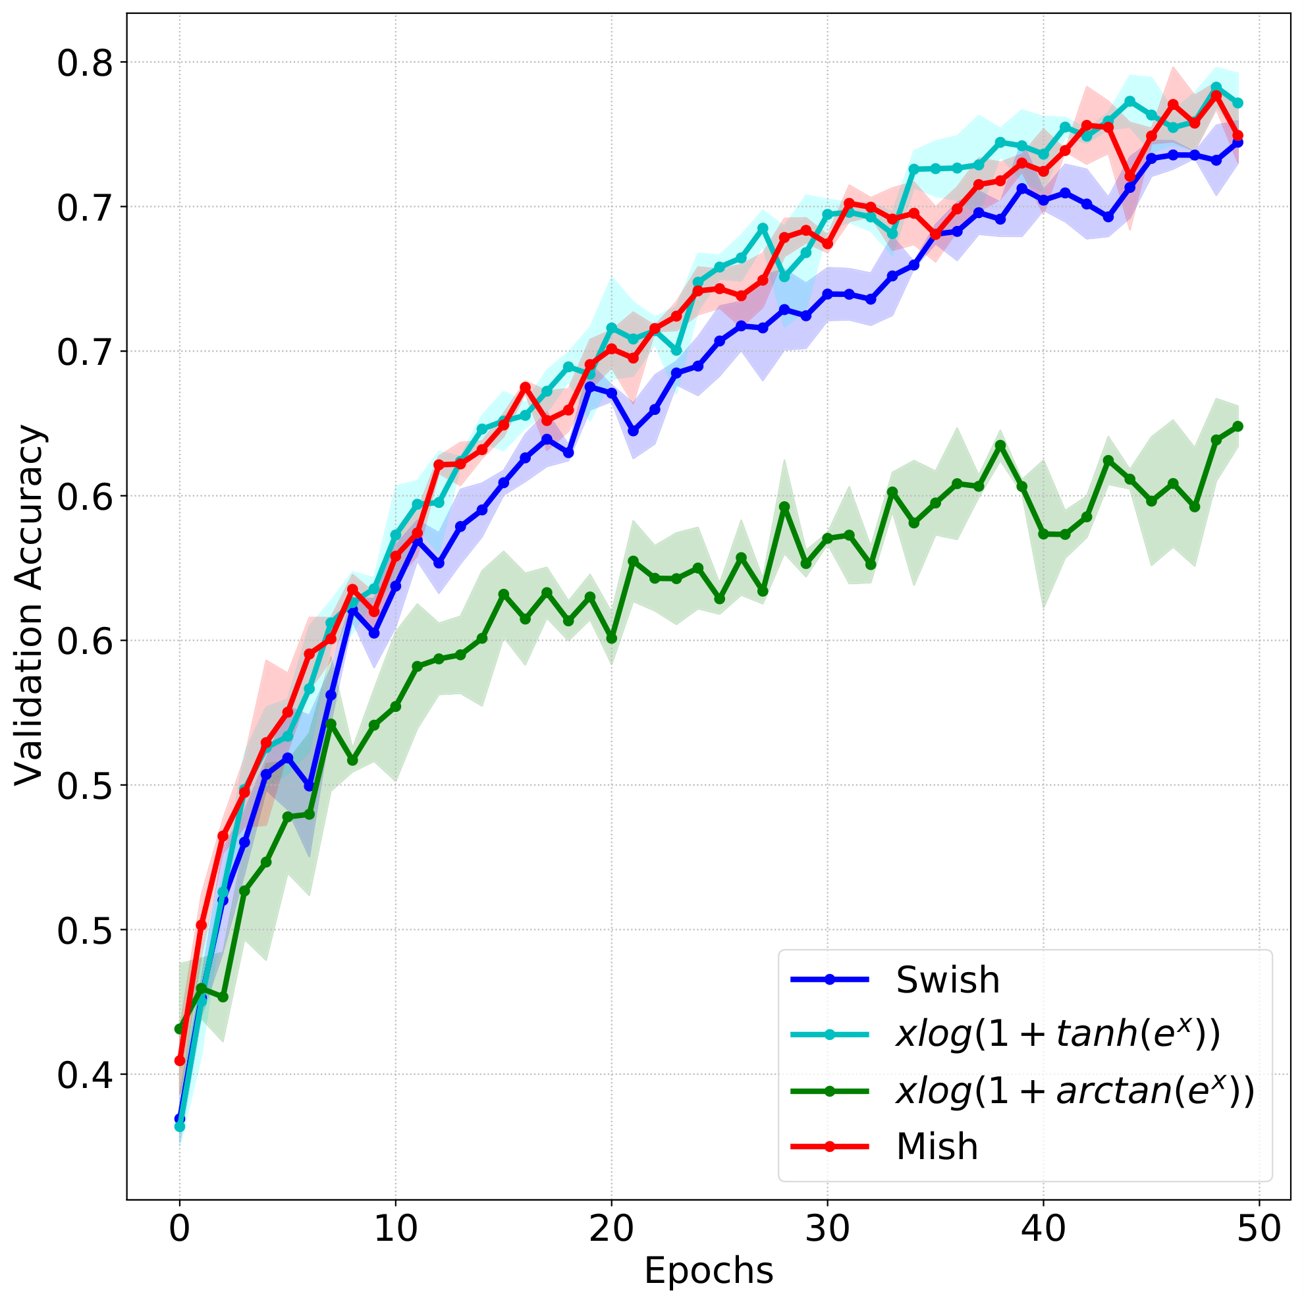
Motivation
We take these definitive properties which are responsible for Swish improved performance as compared to ReLU and construct several candidate functions. The candidate functions chosen include: arctan(x)softplus(x), tanh(x)softplus(x), xlog(1+arctan(e^{x})), xlog(1+tanh(e^{x})) and xtanh(softplus(x)).
We validate these candidates on CIFAR-10 classification task with a ResNet-20 for three runs of 50 epochs each and conclude xtanh(softplus(x)) to be the best and most stable of all which we name as Mish.

Slide 8
Mish
Mish is a smooth self-regularized, non-monotonic activation function which can be mathematically defined as:
f(x) = xtanh(softplus(x))
It uses the self gating property used in Swish and similar to Swish is unbounded above thus avoids saturation and bounded below thus allowing the propagation of small amount of negative weights. Due to the preservation of a small amount of negative information, Mish eliminated by design the preconditions necessary for the Dying ReLU phenomenon. This property helps in better expressivity and information flow.

Slide 9
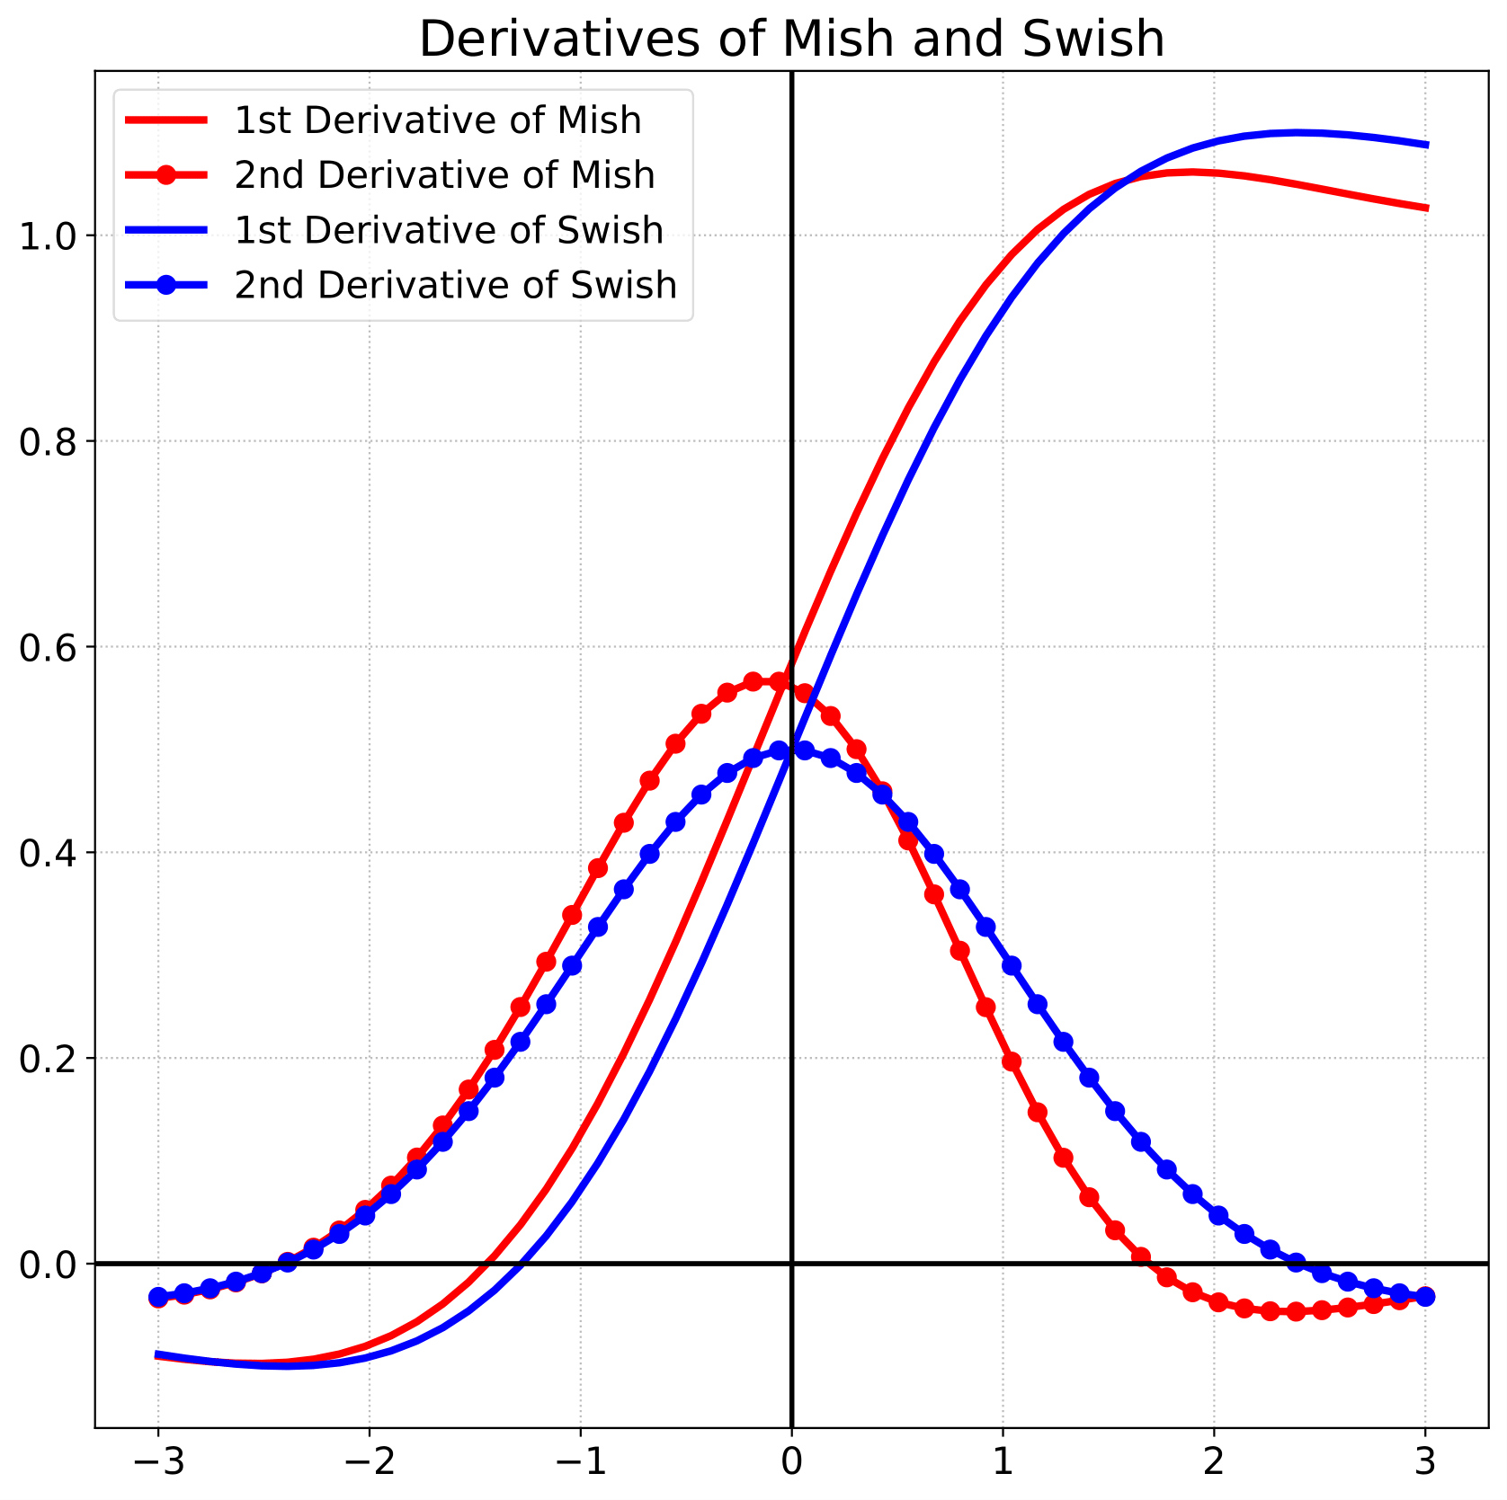
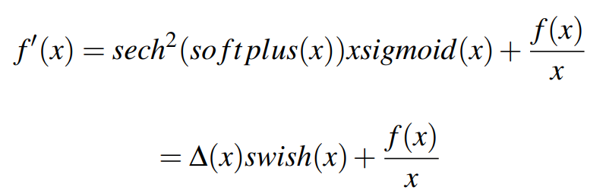
Δ(x) pre-conditioning
Mish is closely related to Swish in the 1st derivative where we observe the Δ(x) component which we hypothesize to be acting as a preconditioner helping to make the gradients smoother thus allowing easier optimization, faster rate of convergence and improved generalization. Additionally, we speculate the symmetric nature of the derivative of Mish to have an effect in it’s improved performance as compared to Swish.

Slide 10
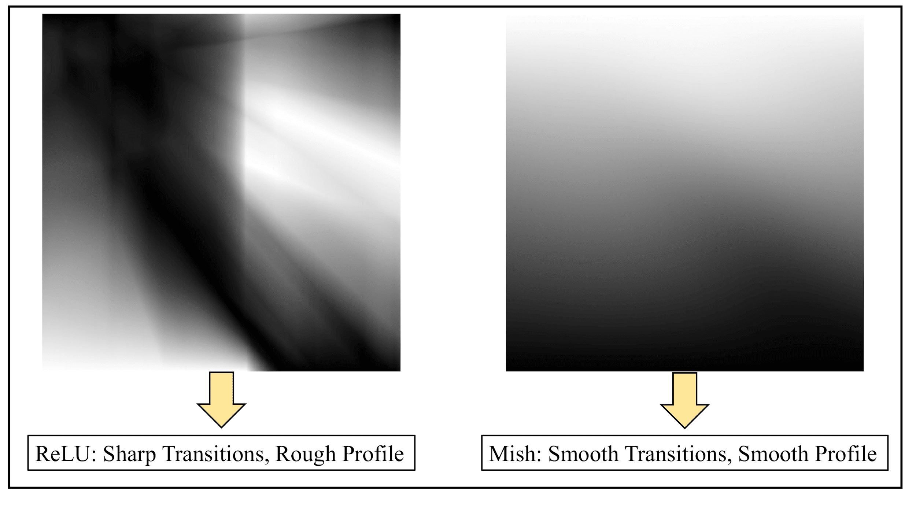
Easier Optimization
We observe the output landscape of a randomly initialized neural network equipped with ReLU and Mish. As demonstrated in the figure, we observe the landscape for ReLU to have sharp transitions and a rough profile. However, for the network equipped with Mish, we observe a smooth and well conditioned landscape which is a crucial factor in explaining the improved performance for networks using Mish as compared to those using ReLU.

Slide 11
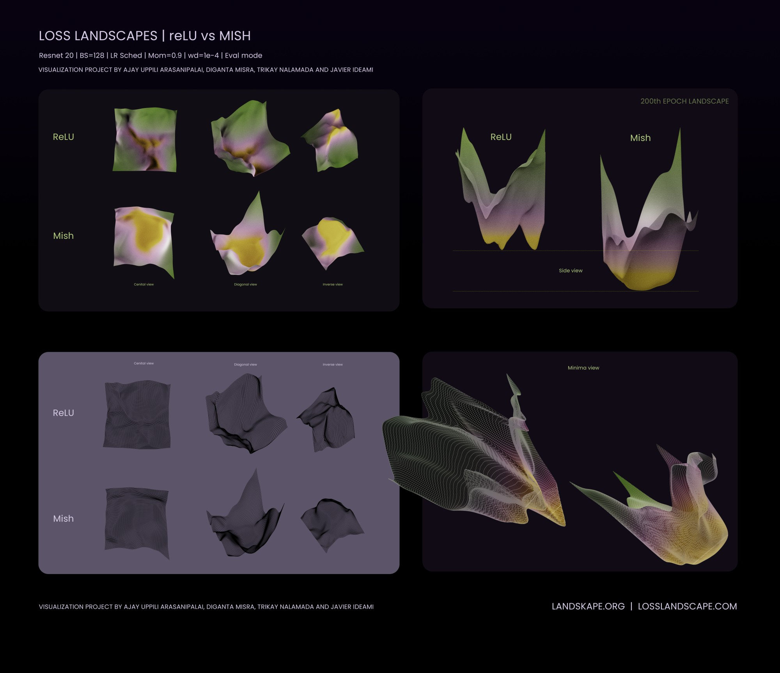
Loss Landscapes
We additionally observe the loss landscapes of a ResNet-20 trained on CIFAR-10 dataset using both Mish and ReLU. As shown, Mish provides a well conditioned, smooth, easy to optimize landscape while that of ReLU is sharp and has multiple local minimas confirmed upon visual inspection. This confirms the connection of loss landscapes with output landscapes of neural networks as discussed earlier.
Visualization Credits - Javier Ideami

Slide 12
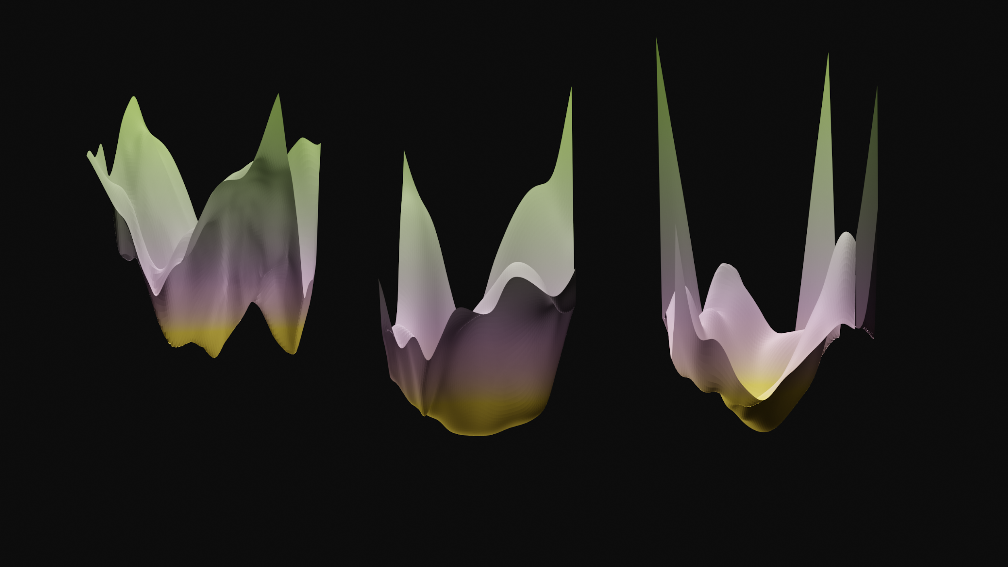
Loss Landscapes
We also observe the loss landscape for ResNet-20 with Swish and compare the same to Mish and ReLU. Although, Swish landscape is well conditioned as compared to ReLU, it is still sharp as compared to Mish. Mish additionally has a wider minima which promotes better generalization as compared to that of both Swish and ReLU. Also, Mish records the highest accuracy and the lowest loss as compared to both Swish and ReLU.
Visualization Credits - Javier Ideami

Slide 13
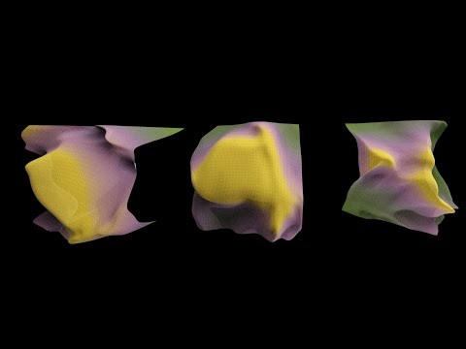
Loss Landscapes
Here, we visually analyze the loss landscapes for Mish, Swish and ReLU in a ResNet-20 architecture for CIFAR-10 image classification task.
The visualization was produced in collaboration with Javier Ideami and Ajay Uppili Arasanipalai.

Slide 14
Robustness
We perform ablation studies to observe the effect of different hyperparameters including depth of the architecture, initialization strategies and magnitude of noise on the performance of different activation functions.
As shown in the figure, Mish performs the best at increasing depth as compared to both ReLU and Swish where the latter two drop accuracy at a fast rate with increasing depth.

Slide 15
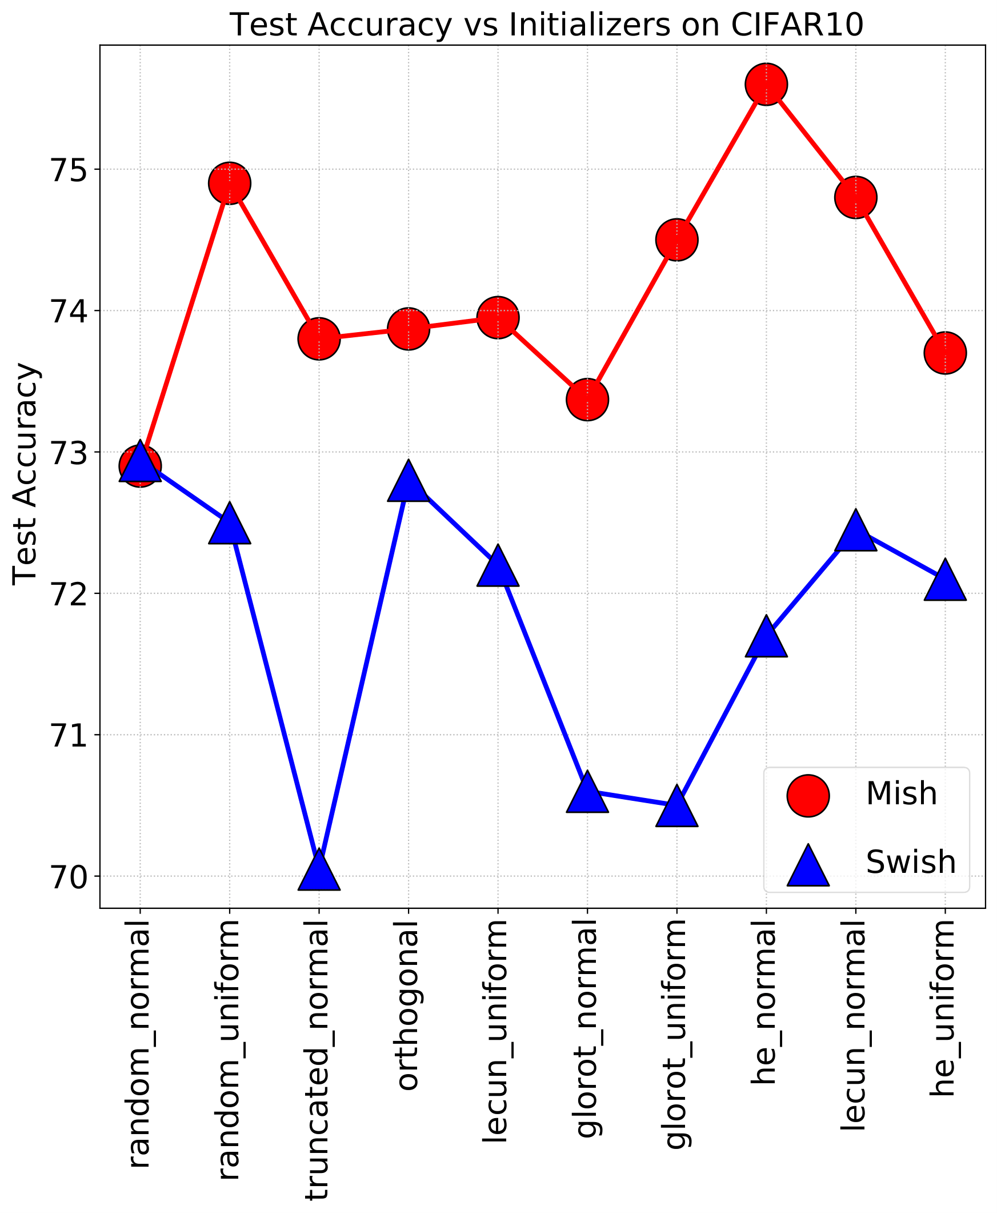
Robustness
We also observe Mish to be more stable and consistently better in accuracy when the network’s weights are initialized using different weight initialization strategies as compared to the same neural network architecture equipped with Swish.
Initialization plays an important role in the performance of different activation functions and has been extensively discussed in Mean Field Theory, thus, this observation is crucial in understanding the underlying dynamics.

Slide 16
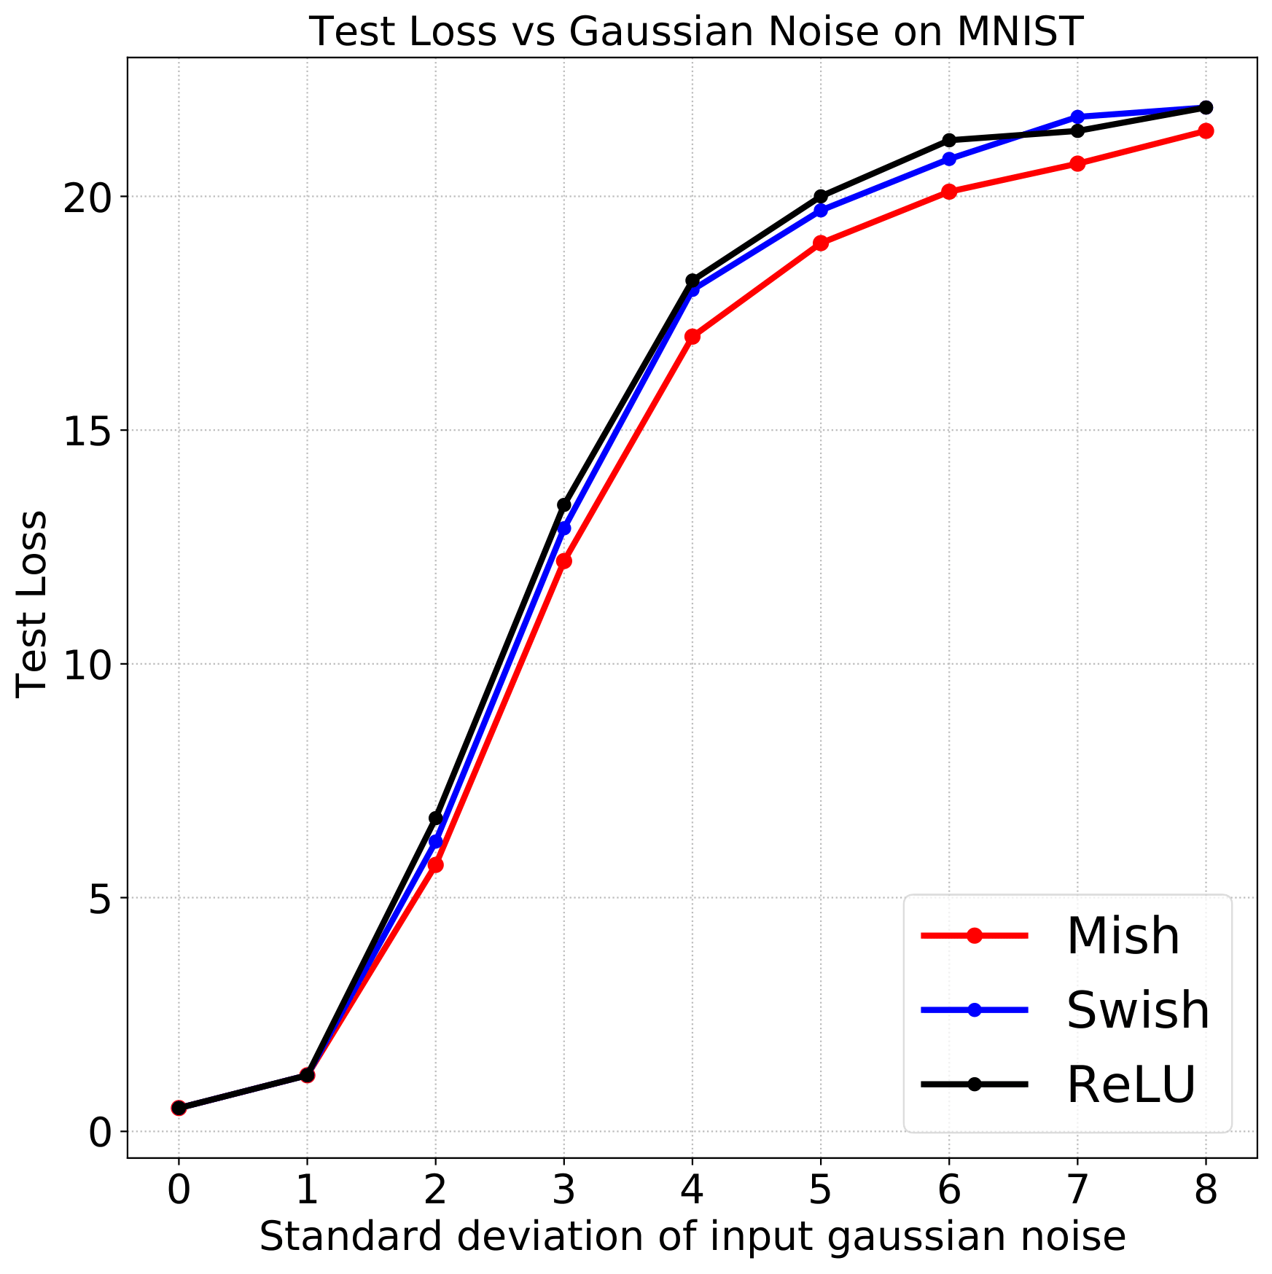
Robustness
We also observe the effect of increasing magnitude of zero centered additive gaussian noise corruption of the input data, in this case - MNIST, to a deep neural network architecture equipped with ReLU, Swish and Mish.
As demonstrated, Mish consistently maintains a lower loss as compared to the architectures equipped with Swish and ReLU which validates the robustness capabilities of Mish.

Slide 17
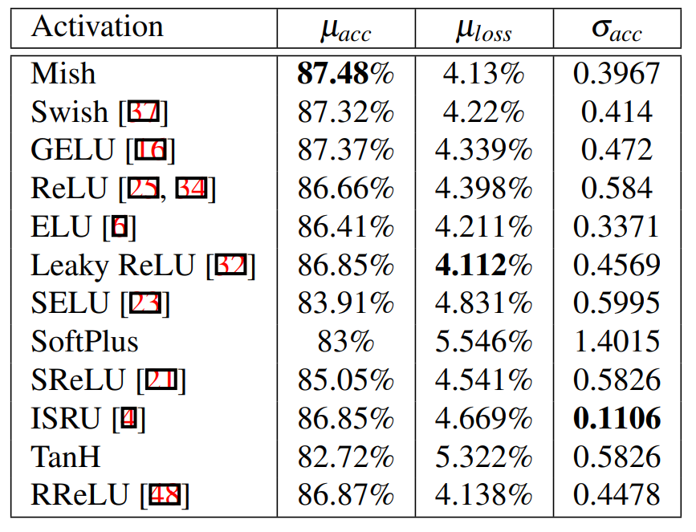
Statistical Analysis
To confirm the stability and consistency of Mish, we trained and compared a Squeeze Net with 10+ activation functions including Mish for CIFAR-10 classification task for a total of 23 runs each for 50 epochs.
As shown in the table, Mish outperforms other activation functions with the highest mean accuracy (µ_{acc}), second-lowest mean loss (µ_{loss}), and third-lowest standard deviation of accuracy (σ_{acc}).

Slide 18
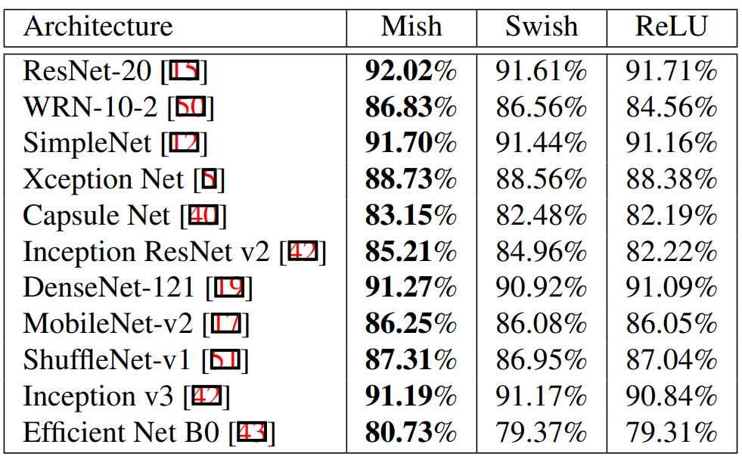
CIFAR-10
We evaluate the performance of Mish on CIFAR-10 classification task using variety of standard neural network architectures including ResNets, Wide ResNets, DenseNets, MobileNets, Efficient Nets, et cetera.
Mish provides consistently better scores as compared to both ReLU and Swish across all the architectures trained in the experiment.

Slide 19
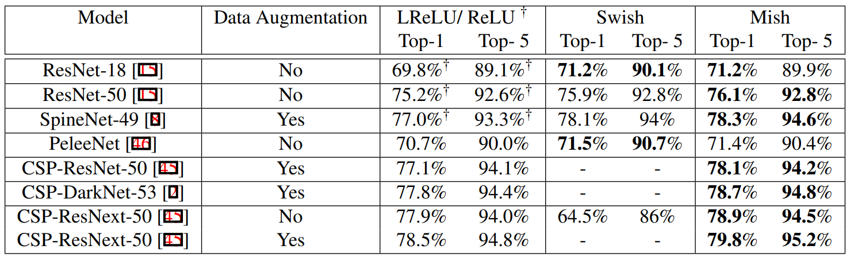
ImageNet-1k
We benchmark different networks on ImageNet-1k classification task using ReLU, Leaky ReLU, Swish and Mish with every other network parameters and hyperparameters kept constant for fair comparison. We observe that Mish provides consistent improvement over both ReLU and Leaky ReLU. While Swish marginally beats Mish in PeleeNet architecture, we observe that it suffers a massive drop in accuracy in more deeper architectures like CSP-ResNext-50. We also validate the impact of different data augmentation strategies including Mixup, Mosaic and Label Smoothing, and confirm them to be aligned to the performance boost obtained by using Mish.

Slide 20
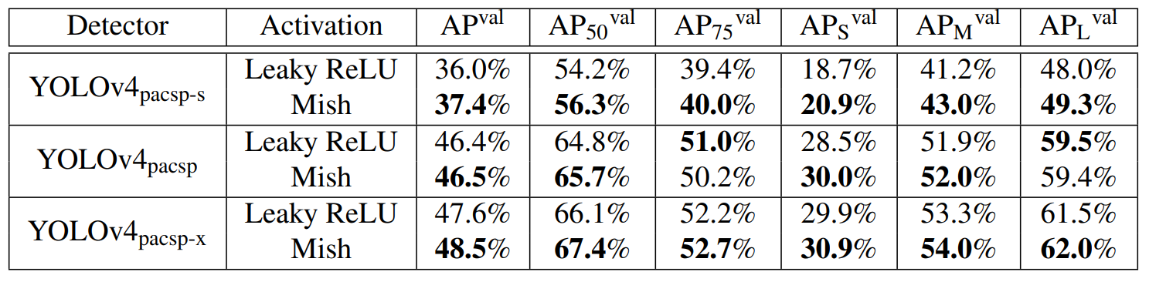
MS-COCO
We compare the performance of Mish and Leaky ReLU in three different variants of YOLOv4 architecture which include: YOLOv4_{pacsp}, YOLOv4_{pacsp-s}, and YOLOv4_{pacsp-x} . Using Mish, we observed a consistent 0.9% to 2.1% improvement in the AP₅₀^{val} on test size of 736. Additional MS-COCO results can be found in the following repositories:
https://github.com/WongKinYiu/PyTorch_YOLOv4
https://github.com/digantamisra98/Mish

Slide 21
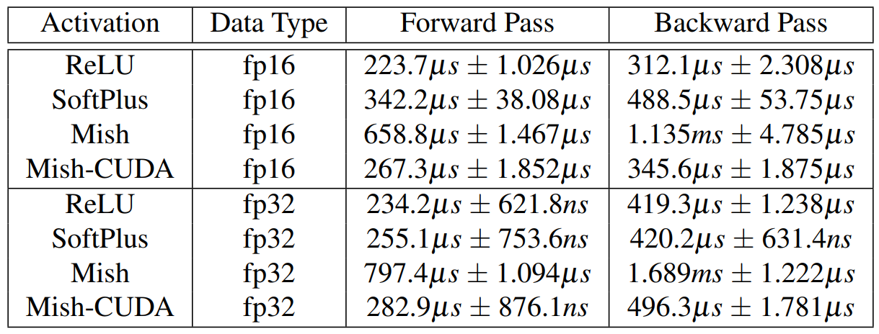
Mish-CUDA
Mish is a novel combination of three different activation functions which include: Identity, TanH and Softplus. Because of the design, there is a trade-off between the accuracy boost and the training complexity. We address this by providing a custom CUDA based implementation which we name as Mish CUDA. Mish CUDA drastically optimizes the performance complexity of Mish and makes it faster than native Softplus in PyTorch both in forward and backward pass in FP16 data-type. Mish CUDA code can be accessed here - https://github.com/thomasbrandon/mish-cuda

Slide 22
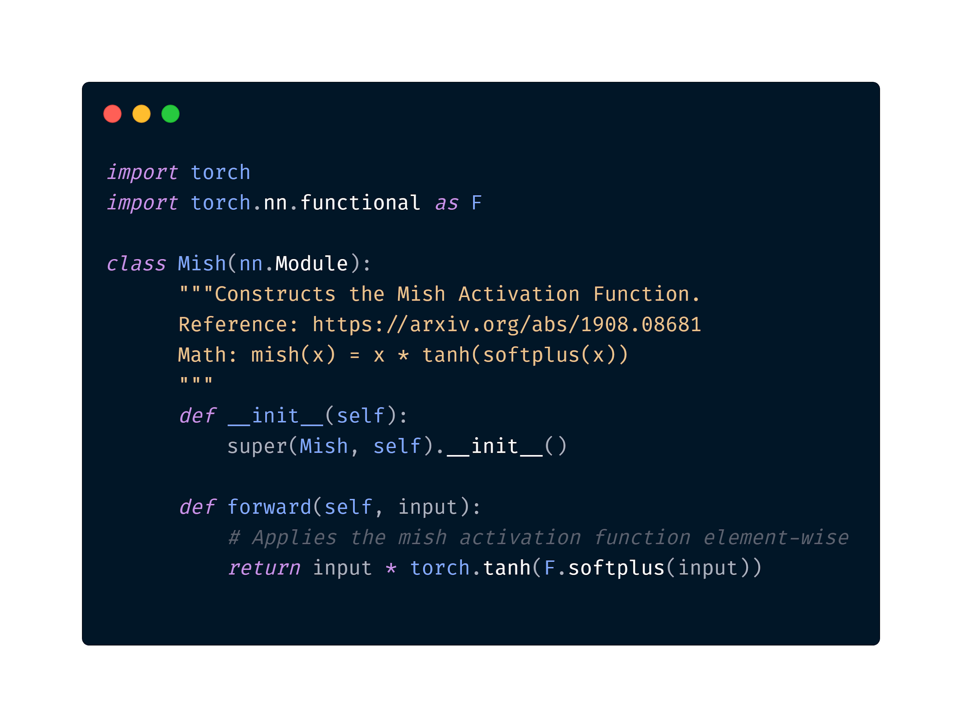
Snippet: Easy to plugin, Easy to validate.

Slide 23
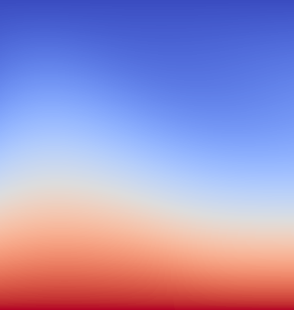
Conclusion
We propose a novel activation function, Mish. We observe the properties governing Mish to provide a favorable effect in the training dynamics of deep neural networks and are also responsible for improved generalization capabilities.
Further work includes investigating the preconditioning effect of the Δ(x) term and also to further reduce complexity of Mish by using the exponential equivalent for the TanH and Softplus terms.

Slide 24
Code and pretrained models available at:
https://github.com/digantamisra98/Mish

Slide 25
References
Bing Xu, Naiyan Wang, Tianqi Chen, and Mu Li. Empirical evaluation of rectified activations in convolutional network. arXiv preprint arXiv:1505.00853, 2015.
Prajit Ramachandran, Barret Zoph, and Quoc V Le. Searching for activation functions. arXiv preprint arXiv:1710.05941, 2017.
Vinod Nair and Geoffrey E Hinton. Rectified linear units improve restricted boltzmann machines. In Proceedings of the 27th international conference on machine learning (ICML-10), pages 807–814, 2010.
Hao Li, Zheng Xu, Gavin Taylor, Christoph Studer, and Tom Goldstein. Visualizing the loss landscape of neural nets. In Advances in Neural Information Processing Systems, pages 6389–6399, 2018.
Dan Hendrycks and Kevin Gimpel. Gaussian error linear units (gelus). arXiv preprint arXiv:1606.08415, 2016.
Kaiming He, Xiangyu Zhang, Shaoqing Ren, and Jian Sun. Delving deep into rectifiers: Surpassing human-level performance on imagenet classification. In Proceedings of the IEEE international conference on computer vision, pages 1026–1034, 2015.

Slide 26
Extras

Slide 27
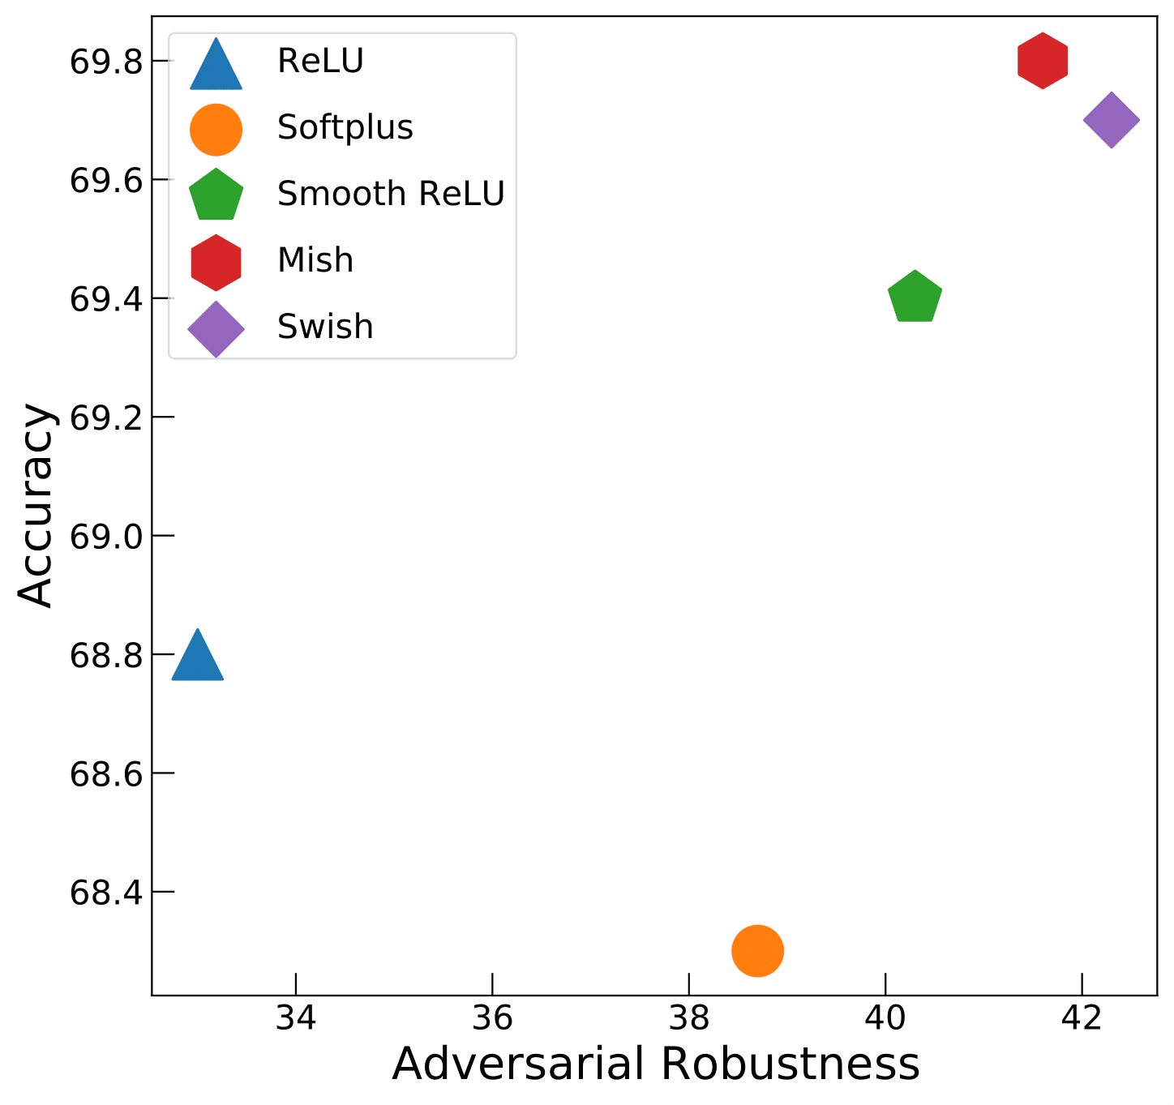
Adversarial Robustness
In the recent paper “Smooth Adversarial Training” by Xie et. al., the authors investigate the impact of different activation functions on the adversarial robustness capabilities of different neural networks.
The authors observe a general trend - Smooth activation functions not only provide a performance boost but also improve the adversarial robustness of the network. This property is also exhibited by Mish as shown in the figure.
Reference - https://arxiv.org/abs/2006.14536

Slide 28
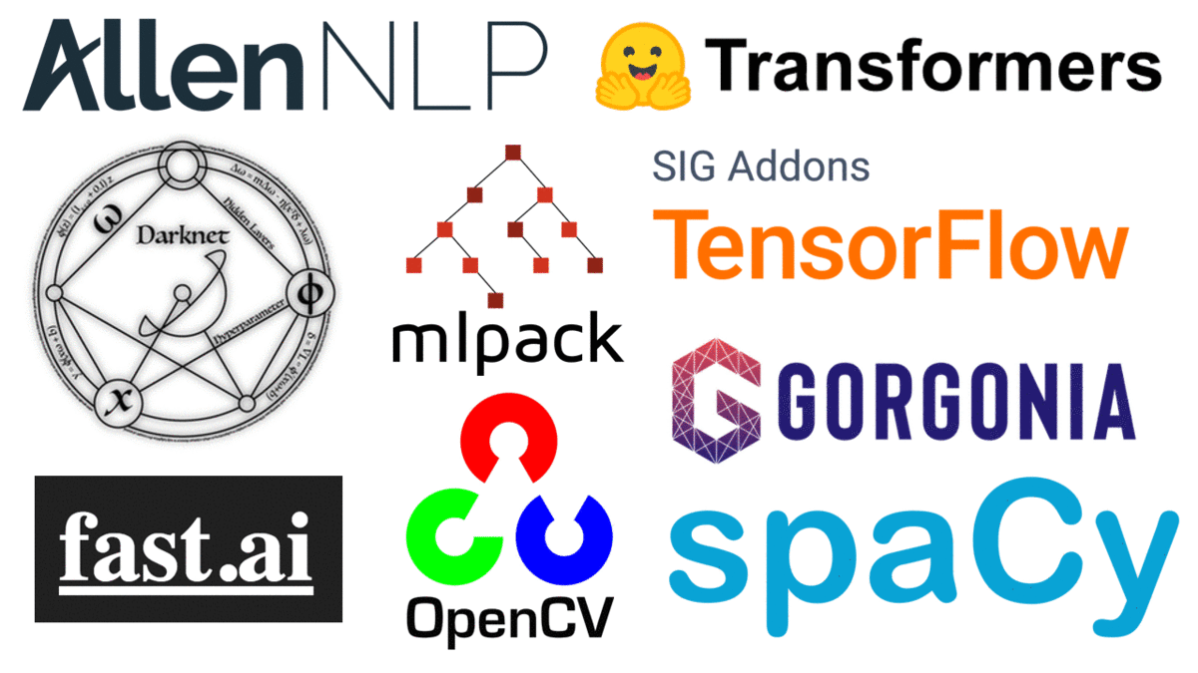
Package Support
Mish is supported in different packages to facilitate easy training with different architectures. Some of the notable ones include:
DarkNet
TensorFlow
Fast.AI
OpenCV
SpaCy
DLib
HuggingFace Transformers
DL4J

Slide 29


Machine Learning Cafe
There was a dedicated episode on the Machine Learning Cafe Podcast hosted by Miklos Toth where the author discussed about non-linear dynamics in neural networks and specifically regarding Mish. The podcast episode is available on Spotify and Apple Podcasts.
Link - http://podcast.machinelearningcafe.org/website/mish-activation-function-with-diganta-misra-007

Slide 30
Thank You!

